Slide 1
Function Calling Harness
Success Rate of Function Calling From 6.75% to 100%
In Qwen-Coder-Next (80b-a3b)
Notes:
안녕하세요. 오늘 발표 제목은 Function Calling Harness입니다. qwen3-coder-next 모델로 쇼핑몰 백엔드의 API 데이터 타입을 생성했을 때, 첫 시도 Function Calling 성공률이 6.75%였습니다. 100번 중 93번이 실패했다는 거죠. 그런데 이걸 100%로 끌어올렸습니다. 어떻게? 더 좋은 모델이나 더 똑똑한 프롬프트가 아니라, Harness를 통해서요. 오늘 그 이야기를 하겠습니다.

Slide 2

TL;DR
AutoBe: AI backend generator
Do not write text codes
Instead, make AST structured data
By AI Function Calling
Types are extremely complicated
Recursive union types
Notes:
전체 요약의 첫 번째, AutoBe입니다. AI가 텍스트 코드를 직접 쓰는 게 아니라 AST 구조화 데이터를 Function Calling으로 채웁니다. 그리고 이 타입들이 굉장히 복잡해요 — 재귀적 유니온 타입들입니다.

Slide 3
TL;DR
TypeScript
import typia, { tags } from "typia";
interface IMember {
id: string & tags.Format<"uuid">;
email: string & tags.Format<"email">;
age: number &
tags.Type<"uint32"> &
tags.ExclusiveMinimum<19> &
tags.Maximum<100>;
}
const check: boolean = typia.is<IMember>(input);
Typia
TypeScript Compiler Plugin
Analyze TypeScript Source Code
  Lenient JSON Parsing
  Type Coercion
  Validation Feedback
Function Calling Success Rate
  6.75% -> 100%
transform
JavaScript (compiled)
((input) => {
return (
typeof input === "object" &&
null !== input &&
typeof input.id === "string" &&
/^[0-9a-f]{8}-.../.test(input.id) &&
typeof input.email === "string" &&
/^[a-z0-9._%+]+@.../.test(input.email) &&
Number.isInteger(input.age) &&
input.age >= 0 &&
19 < input.age &&
100 >= input.age
)
})

Slide 4
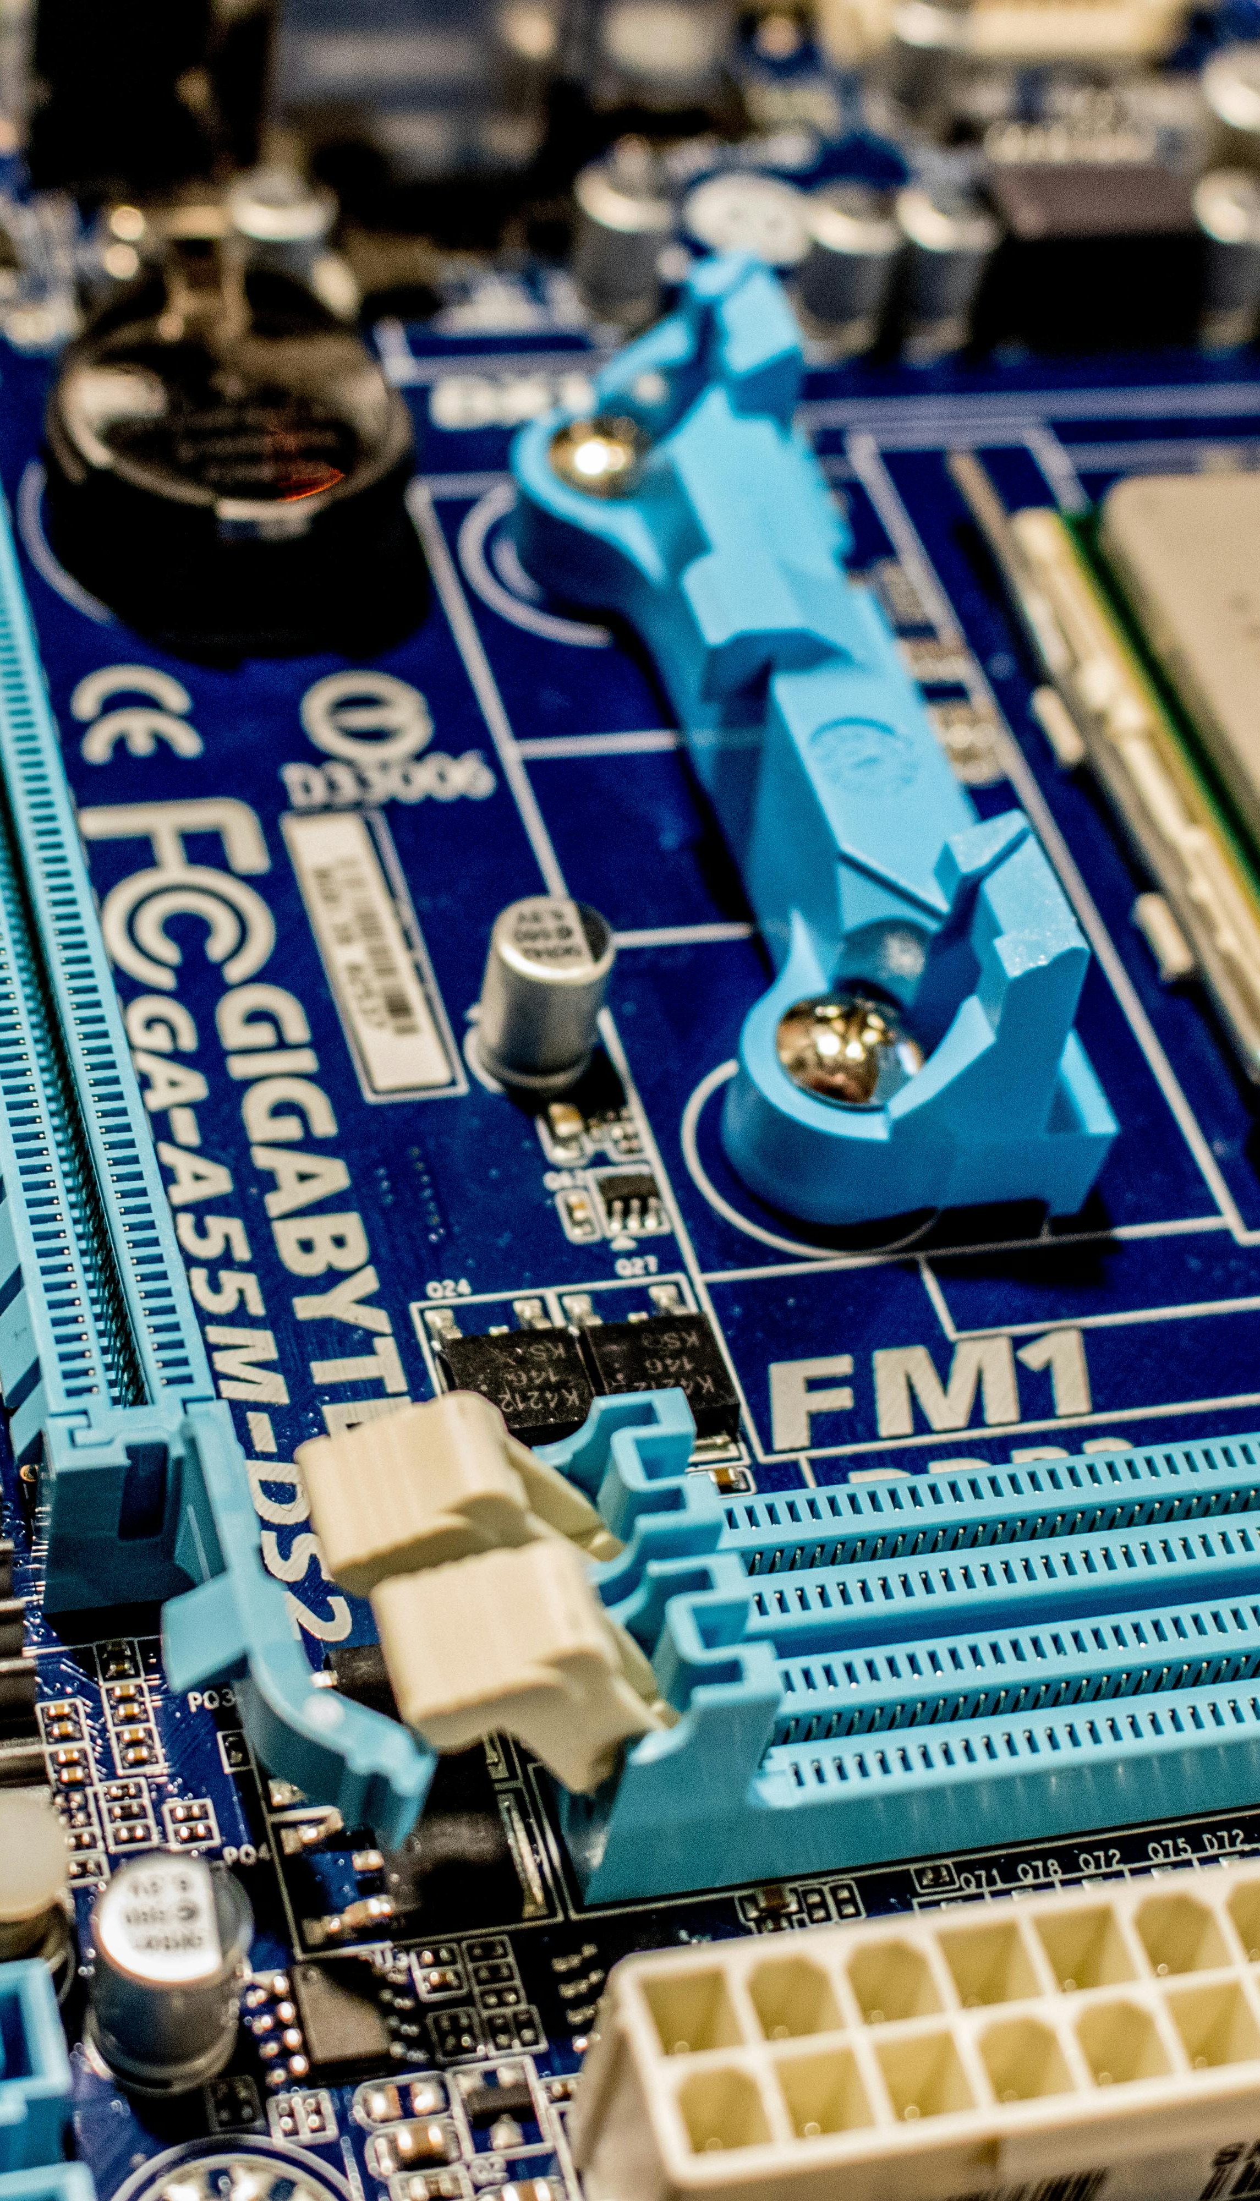
TL;DR
Function Calling
No ambiguity
Model neutral
Mechanically Verifiable
Deterministically Convergent
Notes:
세 번째, Function Calling의 철학입니다. 모호함 제로, 모델 중립적, 기계적으로 검증 가능, 결정론적 수렴. 프롬프트 엔지니어링과는 완전히 다른 패러다임이에요.

Slide 5

TL;DR
Qwen Series
  The best performance for tool calling
  In small/middle size models
    qwen3-coder-next (80b-a3b)
    qwen3.5-35b-a3b
    qwen3.5-24b
    qwen3.5-122b-a10b
Smaller models are the Best for QA
  Take more mistakes
  Expose system vulnerabilities
  Suitable for debugging

Slide 6

1. Preface
NESTFUL (EMNLP 2025)
  GPT-4o: 28% accuracy on nested tool call sequences
  https://arxiv.org/abs/2409.03797
JSONSchemaBench (ICLR 2025)
  3~41% converage on 10,000 real-world schemas (hardest tier)
  https://arxiv.org/abs/2501.10868
BoundaryML (Blog)
  Structured outputs actively degrade model reasoning
  https://boundaryml.com/blog/structured-outputs-create-false-confidence

Slide 7

1. Preface
In Engineering Field,
Free-form text cannot be mechanically verified
Without structure, there can't be mechanical feedback
Without mechanical feedback, no guarantee
So we have to make function calling work
There's no other path for engineering purpose

Slide 8

1. Preface
Function Calling Success Rate for extremely complicate type
  Qwen3-coder-next for DTO schema design: 6.75%
  GPT 5.4 for API specification reviewing: 9.91%
The answer was not a better model or a smarter prompt
  It was on the harness engineering
  Combined with Compiler Skills

Slide 9
100%
Compilation success — all four Qwen models
The answer was not a better model or a smarter prompt.
It was a harness.
Type schemas that constrain
+ compilers that verify
+ feedback that corrects

Slide 10
AutoBe
AI Backend Auto-Generation Agent
Don’t write text code, but make AST structured data

Slide 11
2.1. What AutoBe Does
Build an e-commerce backend with products, carts, orders, and payments
Requirements Analysis (SRS)
Database Schema (ERD)
API Specification (OpenAPI v3.2)
E2E test code
Implementation code
Type-safe SDK for clients

Slide 12
2.2. LLMs Don’t Write Code
Phase | AST Type | Description
Analyze | AutoBeAnalyze | Structured SRS (Software Requirements Specification)
Database | AutoBeDatabase | Database Compiler ensuring Integrity
Interface | AutoBeOpenApi | OpenAPI Compiler for API & DTO Generation
Test | AutoBeTest | Test Compiler for API E2E Testing
Realize | Modular Code | TypeScript Compiler
The LLM fills structures. Compilers write code.

Slide 13
The Forms Are Not Simple
IJsonSchema: 10 variants, infinitely recursive nesting
export type IJsonSchema =
| IJsonSchema.IConstant
| IJsonSchema.IBoolean
| IJsonSchema.IInteger
| IJsonSchema.INumber
| IJsonSchema.IString
| IJsonSchema.IArray // items: IJsonSchema ← recursive
| IJsonSchema.IObject // properties: Record<...> ← recursive
| IJsonSchema.IReference
| IJsonSchema.IOneOf // oneOf: IJsonSchema[] ← recursive
| IJsonSchema.INull;
First-try success rate: 6.75% — 10 variants × recursive nesting = combinatorial explosion
Notes:
LLM이 채워야 할 구조는 결코 단순하지 않습니다. IJsonSchema는 10개 변형의 재귀적 유니온 타입입니다. 배열은 IJsonSchema를 아이템으로 갖고, 객체는 Record<string, IJsonSchema>를 속성으로 갖고, OneOf는 IJsonSchema 배열입니다. 무한히 재귀적인 중첩. 이 타입의 첫 시도 성공률이 바로 6.75%입니다.

Slide 14
IExpression — 30+ Variants, Recursive
Test expression type — programming-language-level complexity in a single function call
export type IExpression =
| IBooleanLiteral | INumericLiteral | IStringLiteral // literals
| IArrayLiteralExpression | IObjectLiteralExpression // compound literals
| INullLiteral | IUndefinedKeyword // null/undefined
| IIdentifier | IPropertyAccessExpression // accessors
| IElementAccessExpression | ITypeOfExpression // access/operations
| IPrefixUnaryExpression | IPostfixUnaryExpression // unary operations
| IBinaryExpression // binary operations
| IArrowFunction | ICallExpression | INewExpression // functions
| IArrayFilterExpression | IArrayForEachExpression // array operations
| IArrayMapExpression | IArrayRepeatExpression // array operations
| IPickRandom | ISampleRandom | IBooleanRandom // random generation
| IIntegerRandom | INumberRandom | IStringRandom // random generation
| IPatternRandom | IFormatRandom | IKeywordRandom // random generation
| IEqualPredicate | INotEqualPredicate // assertions
| IConditionalPredicate | IErrorPredicate; // assertions
30+ variants with recursive nesting
programming-language complexity in one function call
Notes:
테스팅 단계는 복잡도가 한 단계 더 올라갑니다. E2E 테스트 코드는 IExpression이라는 30개 이상의 변형 타입으로 표현됩니다. 리터럴, 복합 리터럴, 접근자, 단항/이항 연산, 함수, 배열 연산, 랜덤 생성, 어서션까지. 프로그래밍 언어 수준의 복잡도를 단일 function call로 처리해야 합니다.

Slide 15
2.3. Self-Healing Loops
Write
Validate
Diagnose
Correct
Generate
↻ repeat until success
Write — LLM fills AST-typed data via function calling
Validate — Typia checks if value conforms to the AST type
Diagnose — Compiler verifies the AST data (DB, OpenAPI, TS)
Correct — On failure, feed precise diagnostics back to the LLM
Generate — Once all checks pass, compiler emits final code

Slide 16
2.4. AST Specs Are Better
Total Control — constraint by structure, not prohibition
Output space is defined by the type, not by rules
Invalid outputs are structurally impossible, not merely forbidden
Total Diagnosis — every failure is mechanically decomposable
Errors localized to exact paths with expected vs. actual
Correction is targeted — only broken fields are retried
Total Portability — model-neutral and language-neutral
Same schema works across any LLM without prompt rewriting
Same schema works across any programming language

Slide 17
2.5. Four Qwen Models, All 100%
Compilation success rate across all tested Qwen models
qwen3-coder-next (3B / 80B) — Coding-specialized → 100%
qwen3.5-397b-a17b (17B / 397B) — Largest MoE → 100%
qwen3.5-122b-a10b (10B / 122B) — Medium MoE → 100%
qwen3.5-27b (27B Dense) — Medium Dense → 100%
qwen3.5-35b-a3b (3B / 35B) — Small MoE → 100%
From 397B to 35B. Same schema, same pipeline, same result.

Slide 18
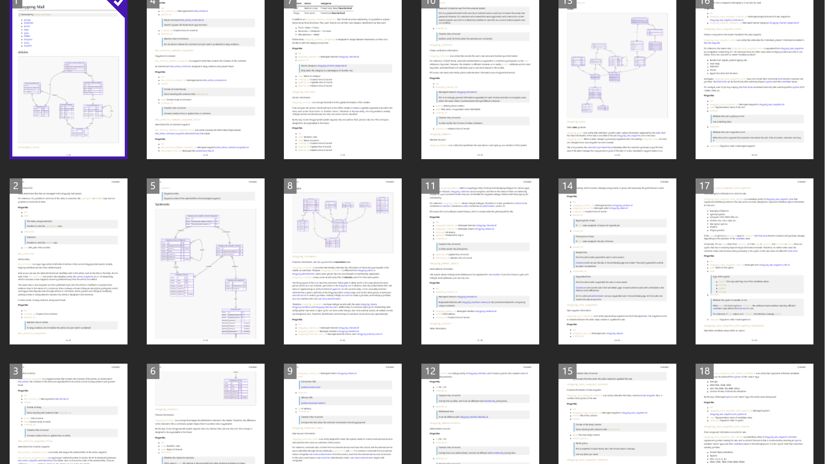

Slide 19
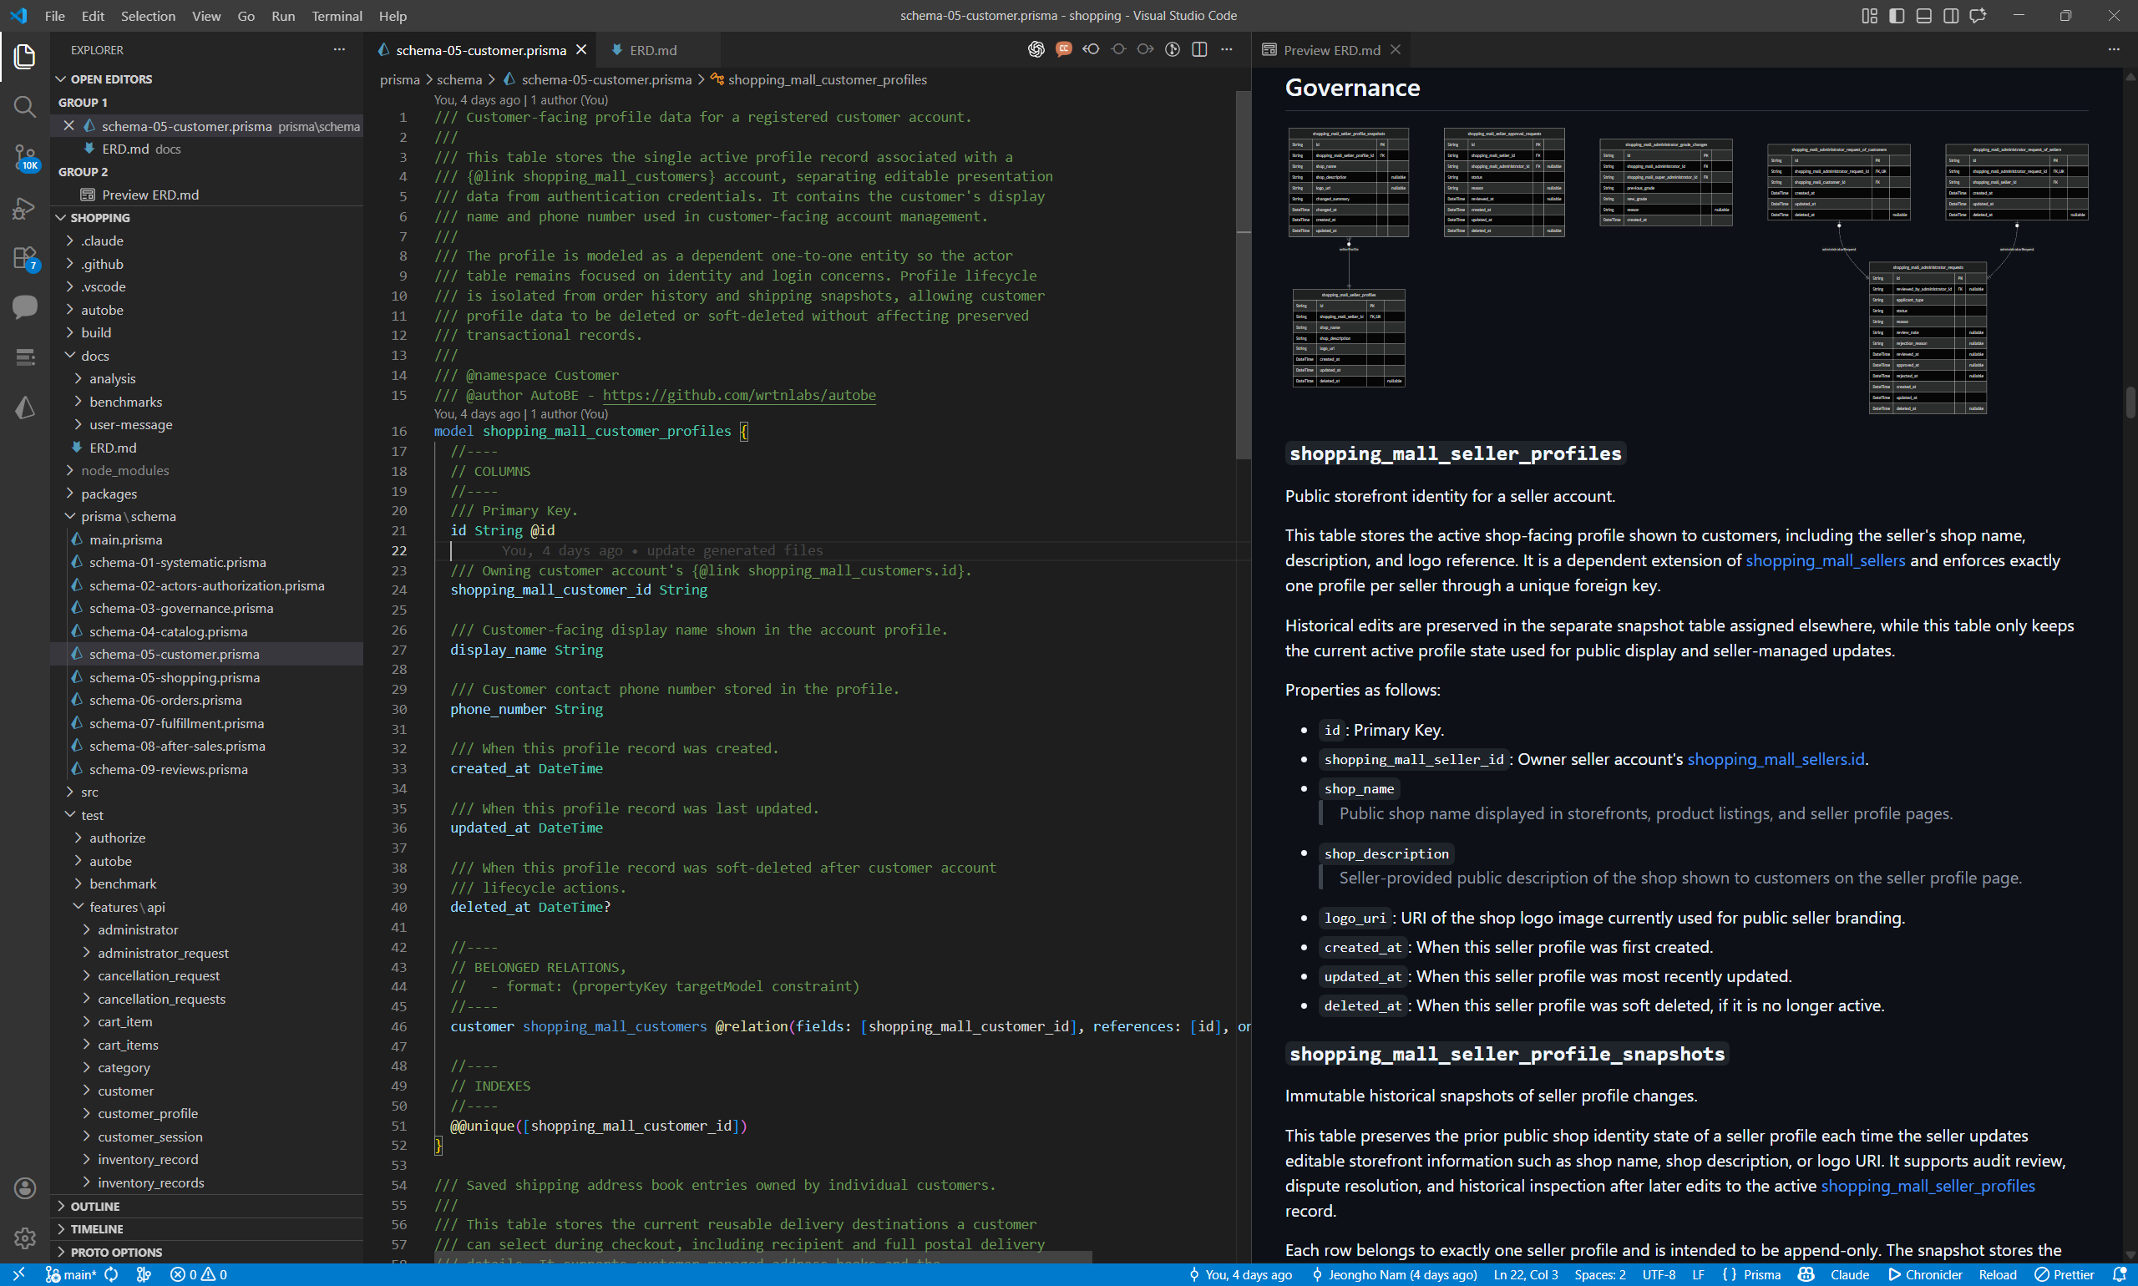

Slide 20
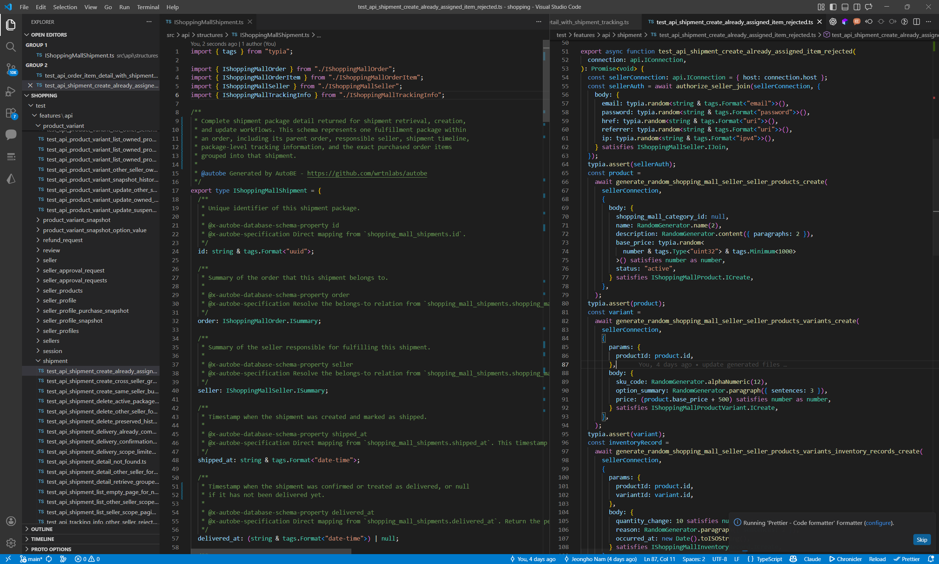

Slide 21
Typia
The Infrastructure for LLM Function Calling
Turns 6.75% into 100% by Compiler Skills

Slide 22
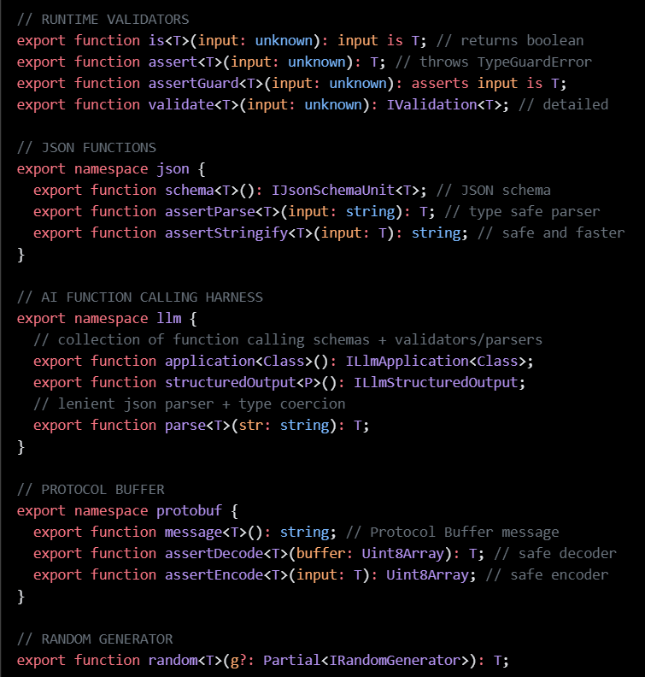
2.1. What Is Typia
A TypeScript compiler plugin that analyzes source code at compile time
Overcomes TypeScript's runtime type erasure
Generates optimal validation code (AOT — Ahead of Time)
20,000× faster than class-validator
One line of code — no extra schema definitions needed
typia.validate<T>(input) — that's it

Slide 23
Typia's Core: TS → JS Transform
Before Compilation: TypeScript
After Compilation: JavaScript
import typia, { tags } from "typia";
interface IMember {
id: string & tags.Format<"uuid">;
email: string & tags.Format<"email">;
age: number &
tags.Type<"uint32"> &
tags.ExclusiveMinimum<19> &
tags.Maximum<100>;
}
const check: boolean = typia.is<IMember>(input);
((input) => {
return (
"object" === typeof input &&
null !== input &&
"string" === typeof input.id &&
/^[0-9a-f]{8}-.../.test(input.id) &&
"string" === typeof input.email &&
/^[a-z0-9._%+-]+@.../.test(input.email) &&
"number" === typeof input.age &&
Number.isInteger(input.age) &&
input.age >= 0 &&
19 < input.age &&
100 >= input.age
);
})
→
A single line — typia.is<IMember>(input)
transforms into UUID regex, email regex, integer + range checks
Notes:
Typia의 핵심 원리입니다. typia.is<T>()를 호출하면 컴파일 타임에 타입 정보가 분석되어 최적화된 검증 코드로 변환됩니다. 왼쪽의 TypeScript 인터페이스가 오른쪽의 UUID regex, email regex, 정수 체크, 범위 체크를 포함한 JavaScript 코드로 변환됩니다. TypeScript의 타입이 런타임에 지워지는 한계를 컴파일러 플러그인으로 극복합니다.

Slide 24
Type → Schema: Automatic Generation
TypeScript Type (input)
Generated JSON Schema (output)
import typia, { tags } from "typia";
interface IMember {
/**
* Member's age.
*
* Only adults aged 19 or older
* can register.
*/
age: number & tags.Type<"uint32">
& tags.ExclusiveMinimum<18>;
email: string & tags.Format<"email">;
name: string & tags.MinLength<1>
& tags.MaxLength<100>;
}
const schema = typia.llm.parameters<IMember>();
{
"type": "object",
"properties": {
"age": {
"type": "integer",
"description": "Member's age.\n...
"exclusiveMinimum": 18
},
"email": {
"type": "string", "format": "email"
},
"name": {
"type": "string",
"minLength": 1, "maxLength": 100
}
},
"required": ["age","email","name"]
}
→
JSDoc comments → description fields | Type constraints → validation rules
One type = LLM guidance + validation rules
Notes:
같은 원리가 function calling에 직접 적용됩니다. typia.llm.parameters<T>()가 같은 타입 분석을 통해 JSON Schema를 생성합니다. JSDoc 주석은 description 필드가 되어 LLM이 어떤 값을 생성할지 안내하고, 타입 제약은 검증 규칙이 됩니다. 하나의 타입 정의가 LLM 가이던스와 검증 규칙을 동시에 생성합니다.

Slide 25
JSDoc → LLM Description
JSDoc Comments → description fields
LLM reads description to decide what values to generate
Type constraints → validation rules
ExclusiveMinimum<18> → "> 18" rule
Format<"email"> → email format check
One type definition simultaneously generates LLM guidance AND validation rules

Slide 26
2.2. typia.llm.application<Class>()
Scales schema generation to entire classes — every method becomes a function calling schema
Each ILlmFunction automatically provides:
parameters — JSON Schema for the LLM to fill
parse() — lenient JSON parsing + type coercion
coerce() — schema-based type conversion
validate() — precise error detection with exact paths
Define one class → get the full function calling pipeline

Slide 27
The Double-Stringify Problem
anyOf union types → 0% success rate, every time, every model
// ✓ Expected (object)
{"type": "card", "cardNumber": "1234-5678"}
// ✗ Actual from LLM (string containing JSON)
"{\"type\":\"card\",\"cardNumber\":\"1234-5678\"}"
// Not a parsing error — it's already valid JSON
// It's a string. JSON.parse() returns a string.
// jsonrepair, dirty-json, LangChain:
// → passes through untouched
// Typia parse() consults the schema:
// schema expects object → string found
// → re-enters parse() on the string value
// → unwraps recursively, any depth
// Qwen 3.5: 0% → 100%
// No model change. No prompt tuning.
Without schema context, double-stringify is invisible

Slide 28
parse() in Action
8 problems at once — all handled by a single func.parse() call
const llmOutput = `
I'd be happy to help! ← prefix text
```json ← markdown block
{
"order": {
"payment": "{\"type\":\"card\“, cardNumber: “\1234" ← double-stringify, but brken
"product": {
name: "Laptop", ← unquoted key
price: "1299.99“, ← string→number
quantity: 2, ← trailing comma
},
"customer": {
vip: tru ← incomplete keyword
← unclosed brackets
`;
const result = func.parse(llmOutput); // ✓ all 8 fixed
Schema-driven recursive parse — not string-level repair

Slide 29
Why parse() Is Different
String-Level Repair (jsonrepair, dirty-json, LangChain)
Fix commas, close brackets, strip Markdown
Output: syntactically valid JSON
✗ Double-stringify passes through undetected
Typia's Schema-Driven parse()
Parses greedily while consulting the schema
String where object expected? → Re-enters parse()
Recursive cycle — unwraps every layer
Schema-aware parsing solves what string-level repair cannot

Slide 30
Schema-Based Type Coercion
"42" as string or number? Depends entirely on the schema.
// Simple coercion — schema-aware
"42" → 42 // schema: number
"true" → true // schema: boolean
"[1,2,3]" → [1,2,3] // schema: array
// The killer: union types (anyOf)
// payment: ICardPayment | IBankTransfer
// LLM returns:
"{\"type\":\"card\",cardNumber:\"1234
// jsonrepair, dirty-json, LangChain:
// → passes through. Valid string. No schema = no clue.
// Typia coerce():
// schema expects object → string found → re-enter parse()
// → { type: "card", cardNumber: "1234" } ✓
Without schema: string-level repair. With schema: structural recovery.

Slide 31
The parse() coerce() Recursive Cycle
parse()
LLM raw output → schema-aware greedy parsing
Broken JSON recovery
String where schema expects object? → Re-enters parse()
coerce()
Typed object → schema-based type conversion
Finds another string-where-object? → Back to parse()
Repeat until all layers unwound
string → parse() → object → coerce() → finds string → parse() → ... → fully typed result

Slide 32
Validation & Precise Feedback
validate() detects violations at exact paths
path: $input.order.product.price
expected: number & Minimum<0> | value: -100
Surgical precision
Exact path + expected type + actual value
= LLM can self-correct in the next attempt
Not "none of the 10 variants matched" — but exactly which field failed and why

Slide 33
LlmJson.stringify() → // ❌ Inline Diagnostics
Errors rendered directly on the LLM's original JSON output
{
"order": {
"payment": {
"type": "card",
"cardNumber": 12345678 // ❌ [{"path":"$input.order.payment.cardNumber","expected":"string"}]
},
"product": {
"name": "Laptop",
"price": -100, // ❌ [{"path":"$input.order.product.price","expected":"number & Minimum<0>"}]
"quantity": 2.5 // ❌ [{"path":"$input.order.product.quantity","expected":"number & Type<\"uint32\">"}]
},
"customer": {
"name": "John Doe",
"email": "invalid-email", // ❌ [{"path":"$input.order.customer.email","expected":"string & Format<\"email\">"}]
"vip": "yes" // ❌ [{"path":"$input.order.customer.vip","expected":"boolean"}]
}
}
}
Exact path + expected type + actual value → LLM self-corrects

Slide 34
The Complete Feedback Loop
callWithFeedback() — the retry pipeline
LLM Call (with previous feedback)
parse() — broken JSON recovery + type coercion + double-stringify unwinding
validate() — schema violation detection
LlmJson.stringify() → // ❌ inline comments on LLM's JSON
feedback → retry (up to 10 attempts)
This is the complete loop that turns 6.75% into 100%.

Slide 35
Harness Engineering: AutoBe + Typia
Typia Layer (Function Calling level)
Type → auto schema generation
Broken JSON recovery (lenient parsing)
Schema-based type coercion
Precise error feedback (validation feedback)
AutoBe Layer (system level)
4 AST types + 4-tier compiler validation
Self-healing loops (diagnostics → correction)
40+ agent collaboration + batch + prompt caching
Typia makes FC I/O robust. AutoBe ensures system-wide consistency. Together = the harness.

Slide 36
One Type Does It All
The 5-Step Pipeline
Compile-time source code analysis
Schema generation — typia.llm.application<Class>()
Parsing + coercion — ILlmFunction.parse()
Validation — ILlmFunction.validate()
Feedback — LlmJson.stringify()
Define a single TypeScript type → Typia handles everything else

Slide 37
"The type is the schema,
the validator,
and the prompt."
The harness is everything around it.

Slide 38
The Harness Loop
LLM Call → parse() → coerce() → validate() → feedback → retry
parse() — recovers broken JSON, strips markdown, closes brackets
coerce() — "42" → 42, "true" → true, unwraps double-stringify
validate() — exact path + expected type + actual value
feedback — // ❌ inline annotations on the LLM's own JSON
retry — LLM corrects only the flagged fields
This is the complete engine that turns 6.75% into 100%.

Slide 39
Function Calling
Types eliminate ambiguity; schemas constrain through absence
Model-neutral, mechanically verifiable, deterministically convergent

Slide 40
4.1. Natural Language vs Types
Types eliminate ambiguity
  ExclusiveMinimum<18> vs "greater than 18"
Schemas constrain by absence, not prohibition
  No "any" in schema → can't generate it
Model-neutral: same schema, any model
Deterministically convergent: 6.75% → 100%

Slide 41
4.1. Natural Language vs Types
Via Prompt:
  "The age field must be a positive integer greater than 18. Don't use string types for numeric fields. All required fields must be present..."
Problems:
  Is ">18" or "≥18"? No way to verify
  Rules multiply endlessly as schemas grow
Via Type:
interface IMember {
age: number
& Type<"uint32">
& ExclusiveMinimum<18>;
}
// ✓ Mechanically verifiable
// ExclusiveMinimum<18> is >18.
// It's an integer. It's required.
// No ambiguity.

Slide 42

4.2. Pink Elephant Problem
"Don't think of a pink elephant“
  "Don't do X" places X at the center of attention
  Paradoxically increases generation probability
With schemas, this problem disappears
  No "any" in schema → LLM cannot generate it
  Field types limited to 7 choices → no "varchar“
Not prohibition, but absence
  Prompts prohibit what you don't want
  Schemas allow only what you do want

Slide 43
4.2. Pink Elephant Problem
Prompt:
  "Don't use the any type"
Schema:
  IJsonSchema = 10 variants
  No "any" in the union
  → Can't generate it
export type IJsonSchema =
| IJsonSchema.IConstant
| IJsonSchema.IBoolean
| IJsonSchema.IInteger
| IJsonSchema.INumber
| IJsonSchema.IString
| IJsonSchema.IArray
| IJsonSchema.IObject
| IJsonSchema.IReference
| IJsonSchema.IOneOf
| IJsonSchema.INull;
// 10 variants. No "any".
// Can't generate what doesn't exist.

Slide 44
4.2. Pink Elephant Problem
Prompt:
  "Don't make object type as literal type"
Schema:
  Exclude<IJsonSchema, IObject>
  Inline object excluded by type
  → Can't generate it
export namespace IJsonSchema {
export interface IObject {
type: "object";
properties?: Record<
string,
Exclude<IJsonSchema, IJsonSchema.IObject>
>;
additionalProperties?:
| boolean
| Exclude<IJsonSchema, IJsonSchema.IObject>;
required?: string[];
description?: string | undefined;
}
}

Slide 45
4.3. Model Neutrality
Prompt engineering is inherently model-dependent
  Optimized for GPT ≠ works on Claude ≠ works on Qwen
Function calling is model-neutral
  JSON Schema means the same regardless of model
  Strong models: 1–2 attempts, weaker: 3–4, both → 100%
Same schema, same pipeline → 100% on all models
  Qwen, GLM, DeepSeek, OpenAI — no model-specific tuning
  "Can this model do it?" → "Which is most cost-effective?"
  Cost = avg retries × tokens/attempt × cost/token

Slide 46
4.3. Model Neutrality
Prompt Fragility — OpenAI Cases
GPT-4 → GPT-4o: same prompts suddenly fail
  github.com/chapman4444/gpt4o-regression-report
GPT-4 → GPT-5: prompt rewrite required
  OpenAI had to ship a Prompt Optimizer tool
  cookbook.openai.com/examples/gpt-5
GPT-4o retirement (2026.03.31): API endpoints shut down
  echostash.app/blog/gpt-4o-retirement

Slide 47
4.3. Model Neutrality
Prompt Fragility — Anthropic + Conclusion
Claude 3.x → 4.x: breaking changes every major version
  Prefill removed, tool versions changed, style shifted
  docs.anthropic.com/en/docs/about-claude/models/migrating-to-claude-4
Every vendor, every version: prompts must be rewritten
  Model-specific tricks = vendor lock-in + technical debt
Type schemas don't break across versions.
JSON Schema is an industry standard — zero rewrite.

Slide 48
4.4. The Core: Verifiability
Function calling brings LLM output into software engineering
Structured output → engineering problem
  Validation is deterministic — pass/fail
  Feedback is precise — "Field X should be Y but got Z"
  Correction converges — fix only that part
Type schema + deterministic validator + structured feedback
  = harness
  6.75% → 100%

Slide 49
4.4. The Core: Verifiability
Type Schema
+ Deterministic Validator
+ Structured Feedback
Prompt engineering tries to make the probabilistic part reliable.
The harness makes the deterministic part airtight.
In domains that demand precision: 6.75% → 100%

Slide 50
4.4. The Core: Verifiability
"The LLM doesn't need to be accurate.
It just needs to be harnessed."
Correctability is not a property of the model —
it's a property of the validation infrastructure.

Slide 51
4.5. This Pattern Is Universal
Every domain where output is mechanically verifiable
Applicable Domains
  Software: type check → compilation → test execution
  Semiconductor: DRC → LVS → SPICE simulation
  Chemical Process: mass balance → energy balance → simulation
  Control Systems: transfer function → stability → time-domain
Inapplicable: creative writing, strategic decisions
  No validator → no feedback loop → no convergence

Slide 52
4.5. This Pattern Is Universal
Semiconductors
Physical rules of chip design are non-negotiable
DRC, LVS, SPICE simulation
  All deterministic validators
Same recursive union + tree structure as AutoBe's IJsonSchema
interface IBlock {
type: "logic" | "memory" | "io"
| "analog" | "pll";
position: IPoint2D;
dimensions: IDimension;
sub_blocks: IBlock[]; // recursive
}
// DRC (fast) → LVS (med) → SPICE (deep)

Slide 53
4.5. This Pattern Is Universal
Chemical Process
Conservation laws are absolute validators
ASPEN and HYSYS: deterministic validation for 40+ years
Mass bal → Energy bal → Process sim
interface IUnitOperation {
type: "reactor" | "distillation"
| "heat_exchanger" | "pump";
inlet_streams: IProcessStream[];
outlet_streams: IProcessStream[];
// Σ inlet = Σ outlet (mass bal)
}
// Mass bal (fast) → Energy bal (med)
// → Process sim (deep)

Slide 54
4.5. This Pattern Is Universal
Interior Design
Minimum passage width, door accessibility, fire regulations
BIM tools like Revit: collision detection for decades
Clearance → Building codes → Lighting/HVAC sim
interface IFixture {
type: "cabinet" | "counter"
| "appliance" | "furniture";
position: IPoint3D;
dimensions: IDimension3D;
clearance_required: number;
}
// Clearance (fast) → Building codes (med)
// → Lighting/HVAC sim (deep)

Slide 55
4.5. This Pattern Is Universal
Control Systems
Bode plots, Nyquist plots, pole placement: 60+ years of analysis tools
Stability is mathematically provable
Transfer fn → Stability → Time-domain sim
interface IControlLoop {
type: "PID" | "MPC" | "LQR"
| "feedforward" | "cascade";
plant_model: ITransferFunction;
sampling_rate: number; // Hz
constraints: IConstraint[];
}
// Transfer fn (fast) → Stability (med)
// → Time-domain sim (deep)

Slide 56
Qwen Series
Small Models and QA Engineering
Why Open Weights Changed Everything

Slide 57
5.1. Small/Medium Models Excel
AutoBe's only criterion: how accurately a model fills complex JSON Schemas
GLM, Kimi — strong FC at large scale
At small/medium scale, Qwen was the only one
Even 3B active params supports tool choice
  Handles 10+ variant recursive unions at 35B class

Slide 58
5.2. R&D Cost: Users vs Developers
For users: even the most expensive model is cheaper than hiring a backend developer
For developers: thousands of generate-compile-feedback cycles per feature
  Commercial models at this scale = financial ruin
Local models make R&D cycles possible
  Experiment without limits, without cost
  6.75% → 100% required hundreds of cycles — only possible with local models

Slide 59
5.3. Small Models = Best QA Engineers
Large models' advantage = their blind spot
  "Correctly guess" ambiguous schemas — our mistakes stay hidden
Small model results:
  qwen3-30b-a3b (3B active): ~10% — found fundamental schema ambiguities
  qwen3-next-80b-a3b (3B active): ~20% — found subtle type mismatches
10% success = most valuable result
  Every failure → system vulnerability → fix for ALL models

Slide 60
5.4. No Vendor Lock-In
Commercial API risks:
  Pricing changes at vendor's discretion
  Model deprecations — today's model could disappear tomorrow
  Request limits
AutoBe's function calling schemas are model-neutral
  No model-specific prompt tricks
  JSON Schema + type-based validation = industry standards
  System unchanged even when models change

Slide 61
5.5. Open Source + Open Weights: Virtuous Cycle
AutoBe = open source (AGPL 3.0)
Qwen = open weight
The virtuous cycle:
  AutoBe strengthens its system using Qwen
  Strengthened system proves Qwen's production viability
  Qwen's improvements raise AutoBe's performance
  AutoBe's discoveries (e.g., double-stringify) can contribute to Qwen

Slide 62
Conclusion
6.75% → 100%

Slide 63
Conclusion
➜ Communicate through types and there are no misunderstandings
➜ Constrain through schemas and there are no pink elephants
➜ With a deterministic loop, even 6.75% becomes 100%
➜ This pattern transfers to every domain with deterministic validators
Type Schema + Compiler + Feedback = Deterministic Loop

Slide 64
The Journey
6.75% Raw function calling success
  ↓
Typia Parse → Coerce → Validate → Feedback
  ↓
Loop Deterministic harness overcomes probabilistic LLM
  ↓
100% All 4 Qwen models, same harness — transferable to all domains

Slide 65
Three Principles
Types > Prompts
Schemas > Prohibition
Validation > Accuracy

Slide 66
6.75% is not a failure —
it's the first input to the loop.
If you can verify, you converge.

Slide 67
Thank You
Developed by Wrtn Technologies · wrtn.io
Function Calling Harness · Qwen Meetup Korea

